Slide 1
Reinforcement Learning Under Moral Uncertainty

Slide 2
Types Environment
Classic
Twoswitch
Double
Guard
Doomsday
Threedoomsday
extended_doomsday
Multidoom
extended_multidoom

Slide 3
Methods
Nash voting
Variance voting
Stochastic voting
Credence update
Budget Scaling and Theory Individuation

Slide 4
RL Algorithms
PPO2
Variance SARSA
Deep SARSA with ADAM optimizer
Tabular SARSA

Slide 5
State and Action
State contains the presence of switch, people as a one hot encoding in grid along with credences on theory and no of people on track
Action (up, down, left, right)

Slide 6
Credence
Initialization a = np.random.rand()
probs = np.array([a, 1 - a])
probs = np.round(probs * credence_granularity ) / credence_granularity
Credences=probs
credences = se['credences'] /np.sum(['credences'])

Slide 7
Dempster credence
As the credence generated is random and ranges between 0-1.
credence=[0.3510981, 0.6489019]
m_u=[credence[0],1-credence[0],0] m_u=mass function for utilitarian
m_d=[credence[1],1-credence[1],0] m_d = MF for deontologist
m_u=[0.3510981, 0.6489019, 0]
m_d=[0.6489019, 0.351098097, 0]
{'blfU': 0.5, 'blfD': 0.5, 'blfUD': 1.0}
{'plsbU': 0.5, 'plsbD': 0.5, 'plsb_theta': 1}
Dempster_credence=[0.5, 0.5]

Slide 8
Comparative analysis Random credence and Dempster Credence

Slide 9
Modifications WRT Dempster Credence
Mass functions are generated using the randomized credence values.
Mass function hold three values, 1st have the value that supports the theory i.e the credence value on the theory, 2nd have the value that opposes the theory i.e 1-credence on the theory, and third value is 0 as a theory cannot be both utilitarian and deontologist at a time. This step is carried out to generate mass function of utilitarian and deontologist.
These mass functions are used to generate the belief scores on the theory using dempster shafer theory. Later these belief scores are used as the dempster credence.
We have observed that when the random credence value is updated with dempster credence, utilitarian got the chance to choose the action most of the times in nash voting where most of the people are saved by choosing the switch

Slide 10
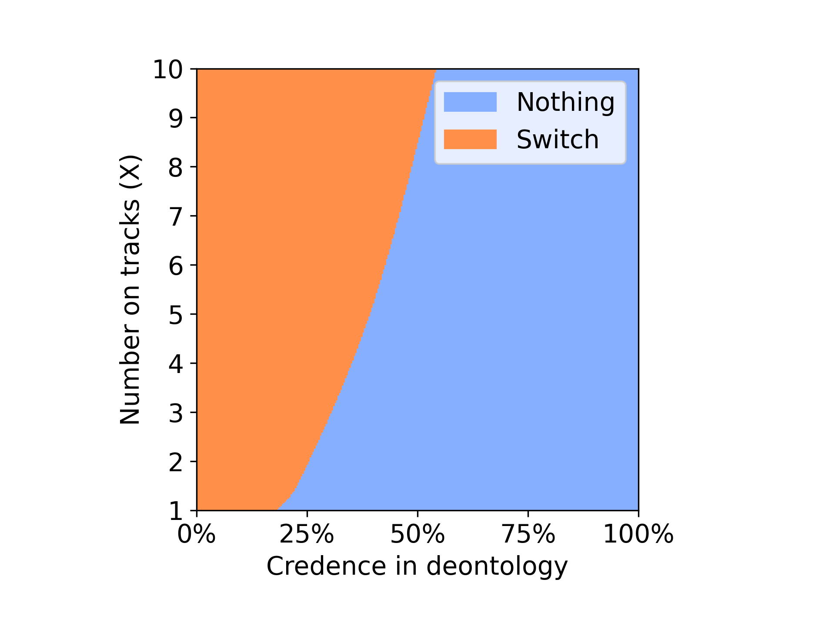
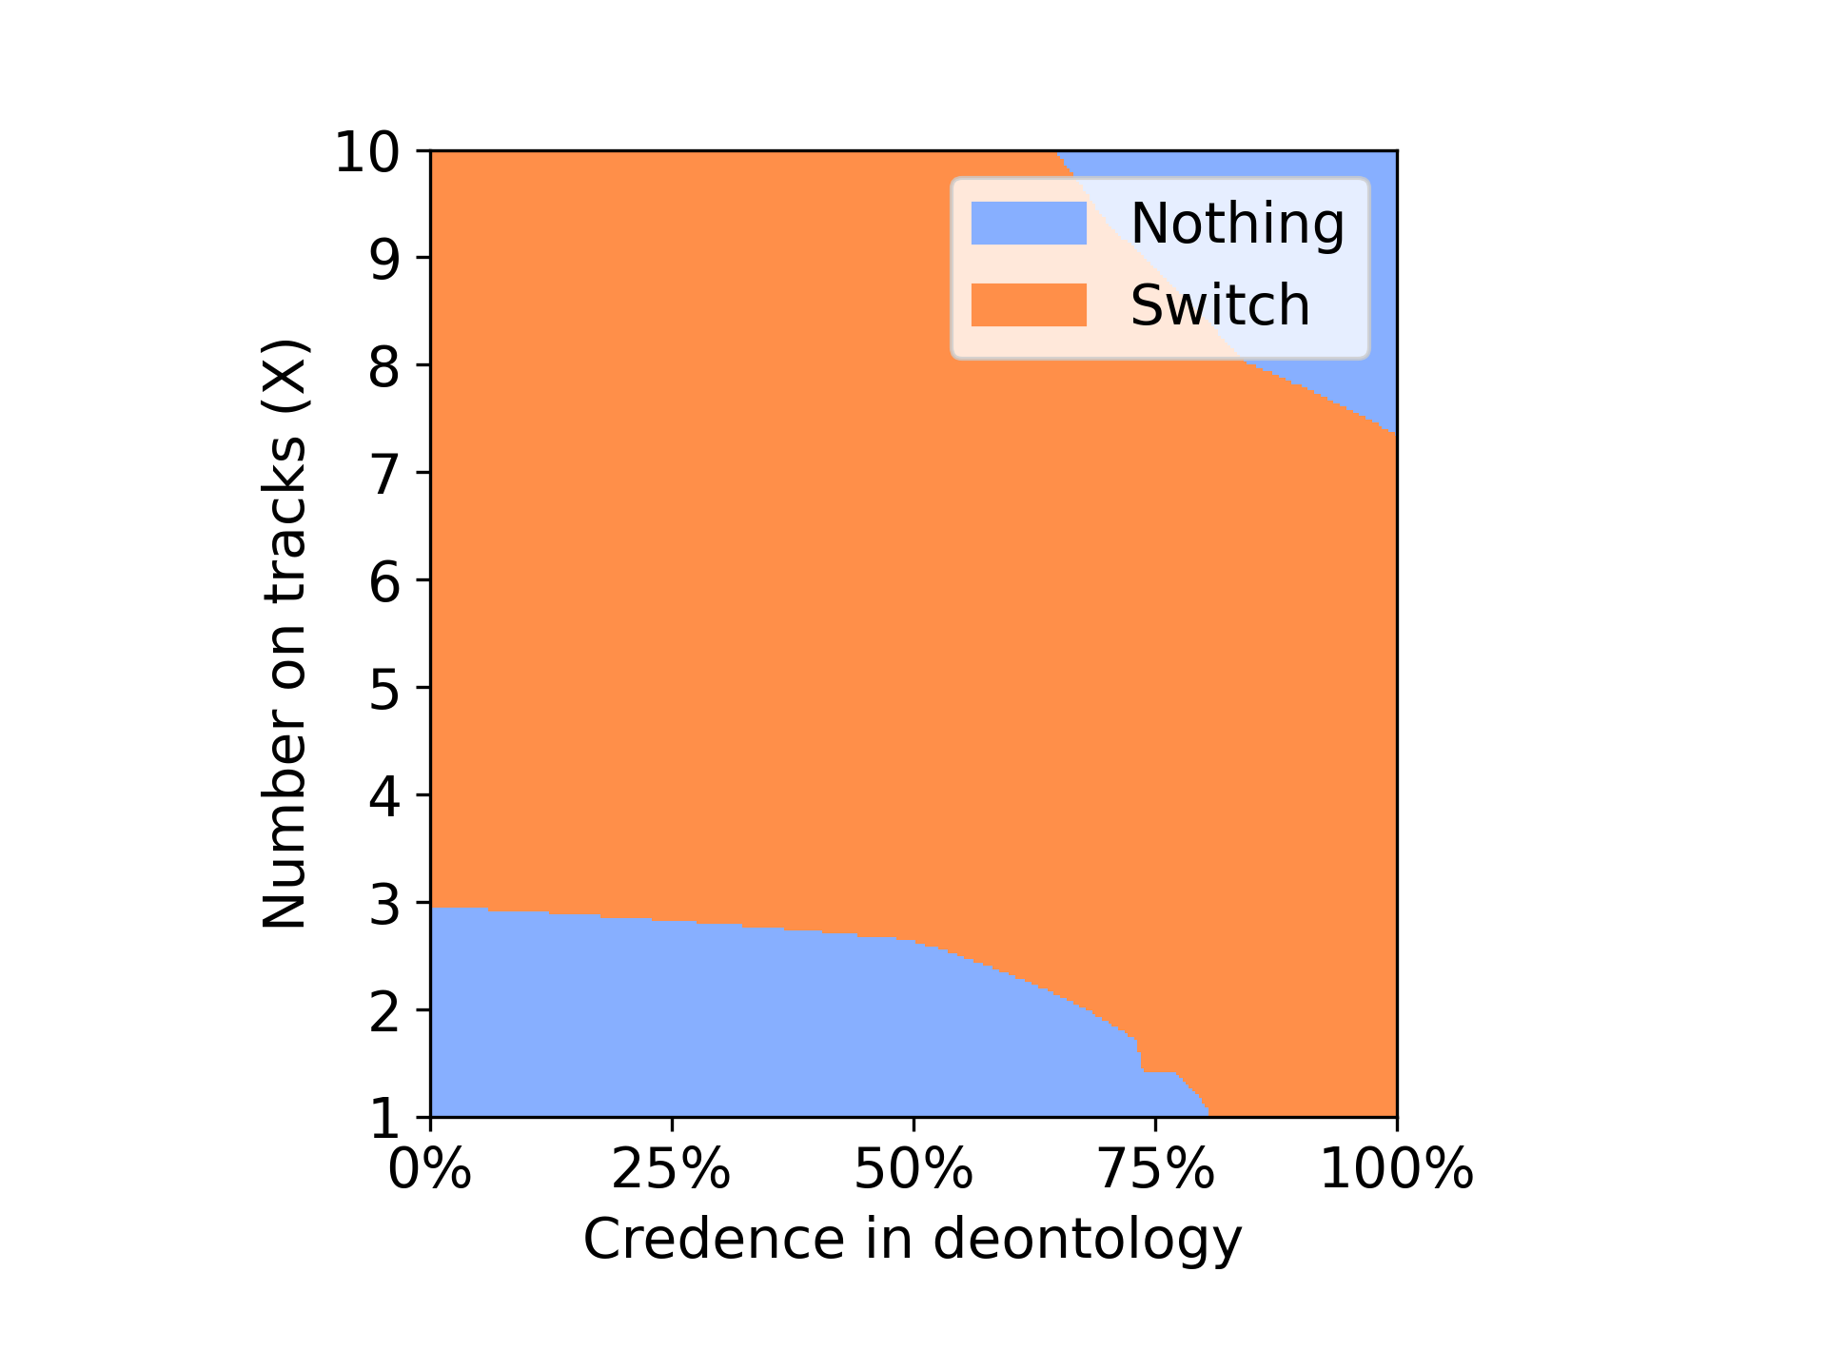
Random credence Dempster Credence
Env: Classic, Voting method : Nash Voting
Notes:
When compared with random credence, agent with dempster credence have opt to switch when the number on tracks is greater than 3. Agent with random credence choose to do nothing after the 50% training phase, but with dempster credence agent was able to choose switch.

Slide 11
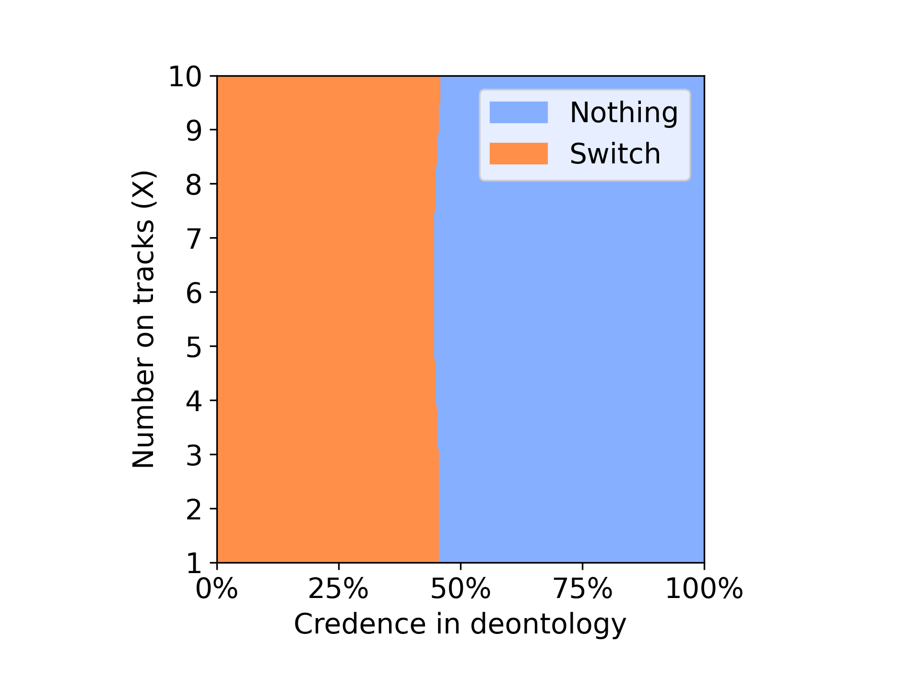
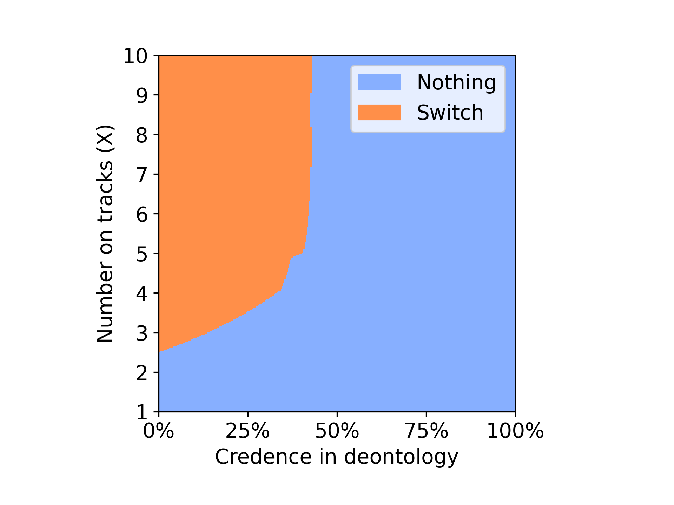
Random credence Dempster Credence
Env: Classic, Voting method : Nash Sequential Voting
Notes:
In Nash sequential Voting method dempster credence showed less dominance. It chooses to do nothing after 50% of the training phase.

Slide 12
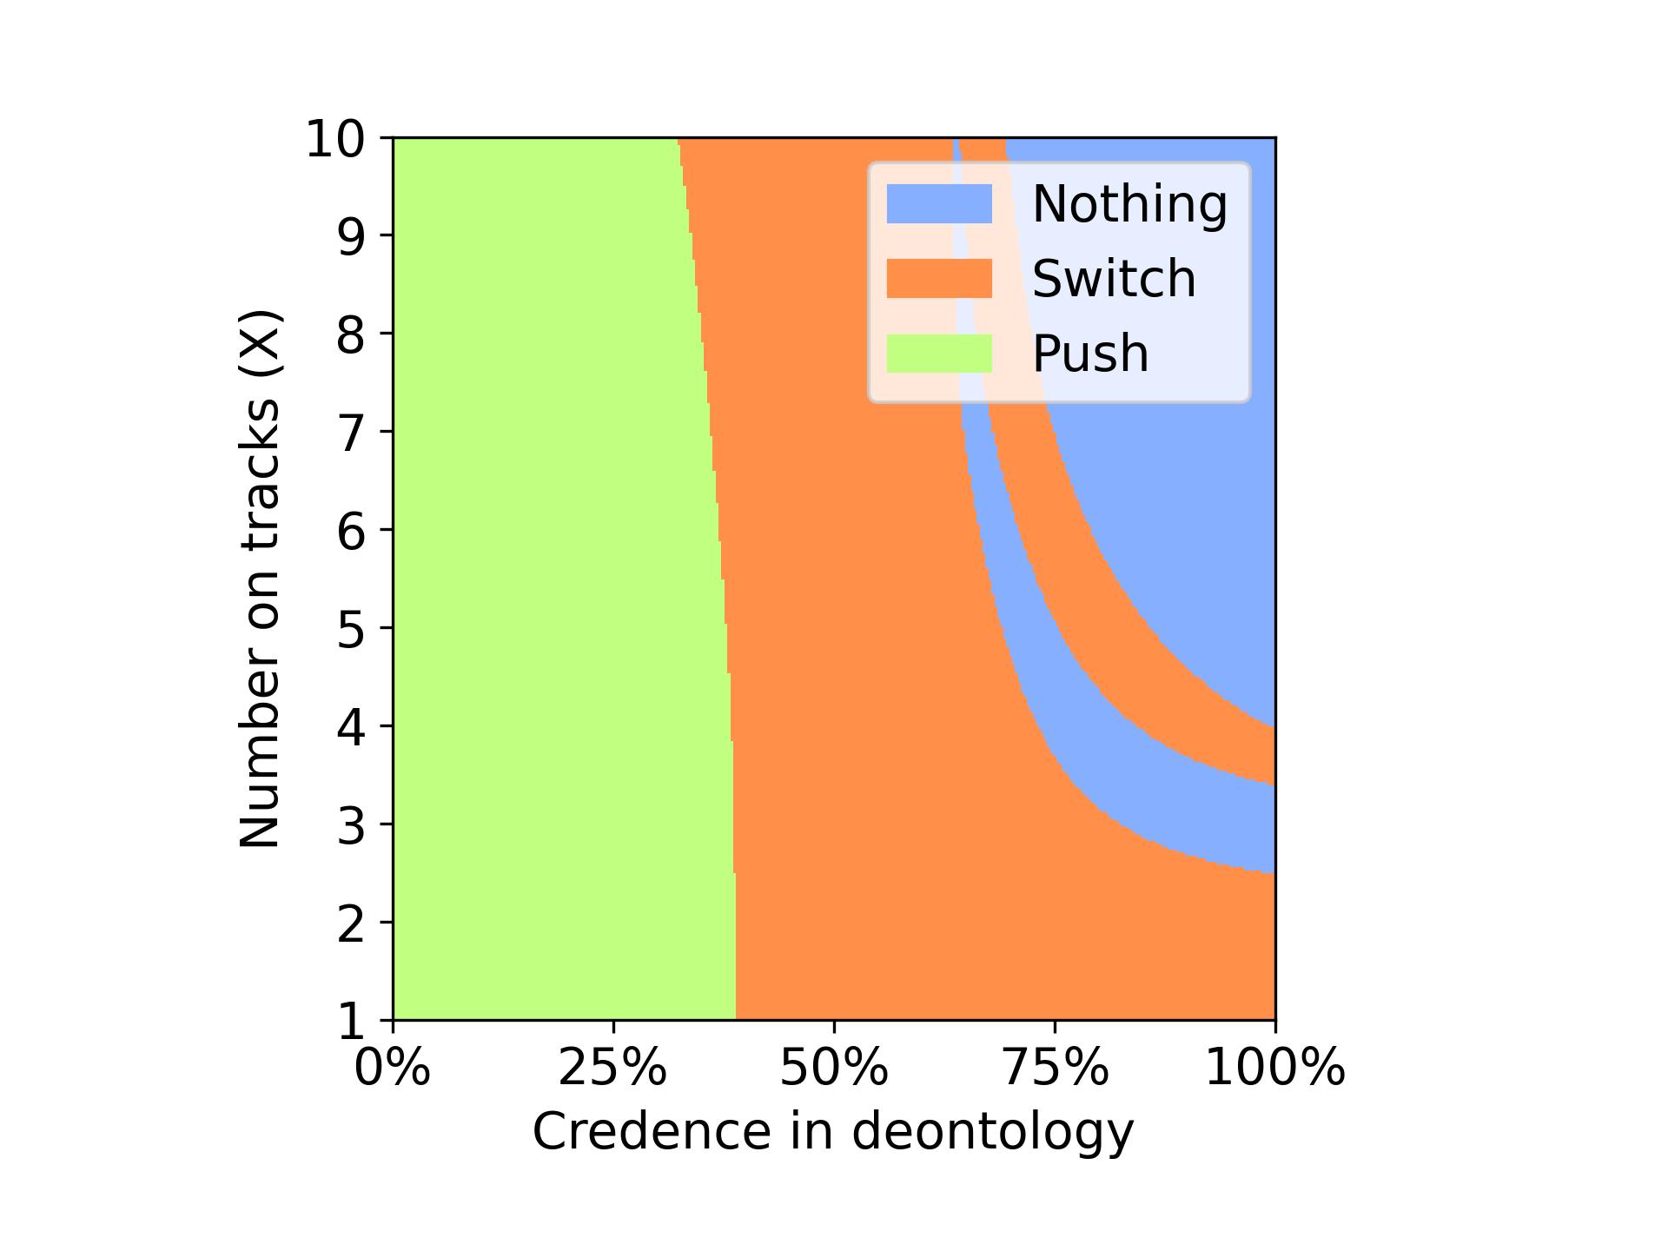
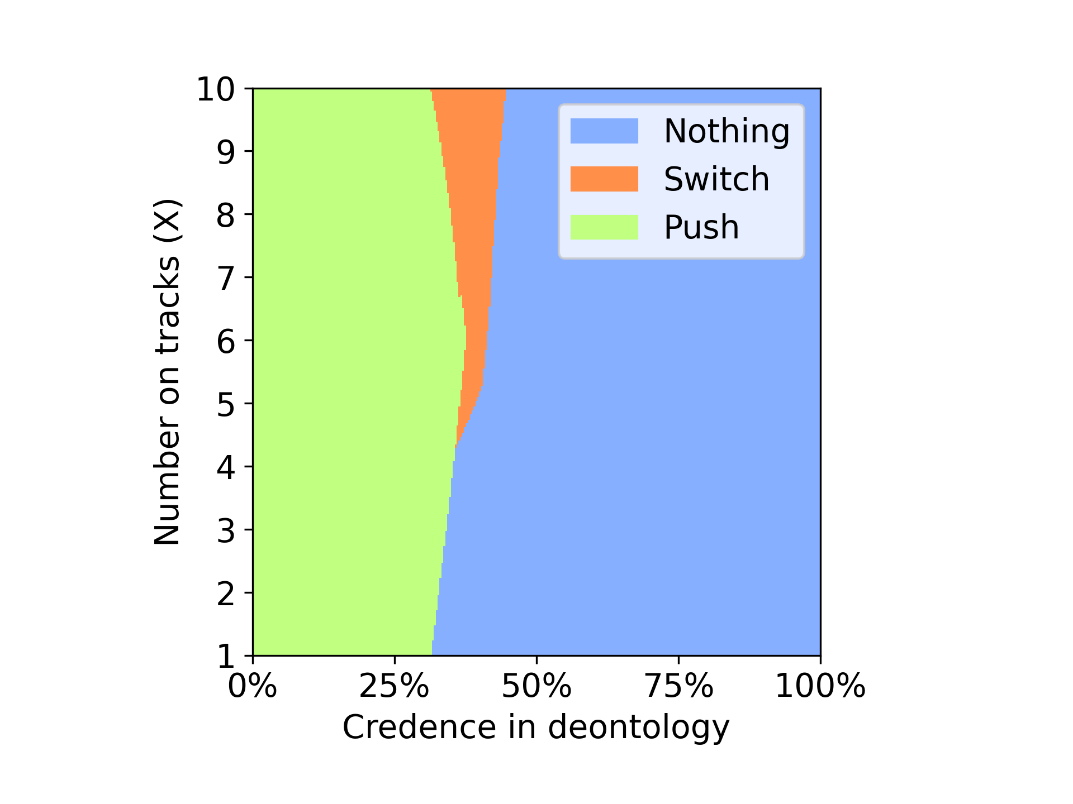
Env- Double , Voting method: nash
Random credence Dempster Credence
Notes:
In a Double environment with nash voting the agent with Dempster credence choose to do nothing after 50% of training, the utilitarian choices are only observed in the first half of the training phase

Slide 13
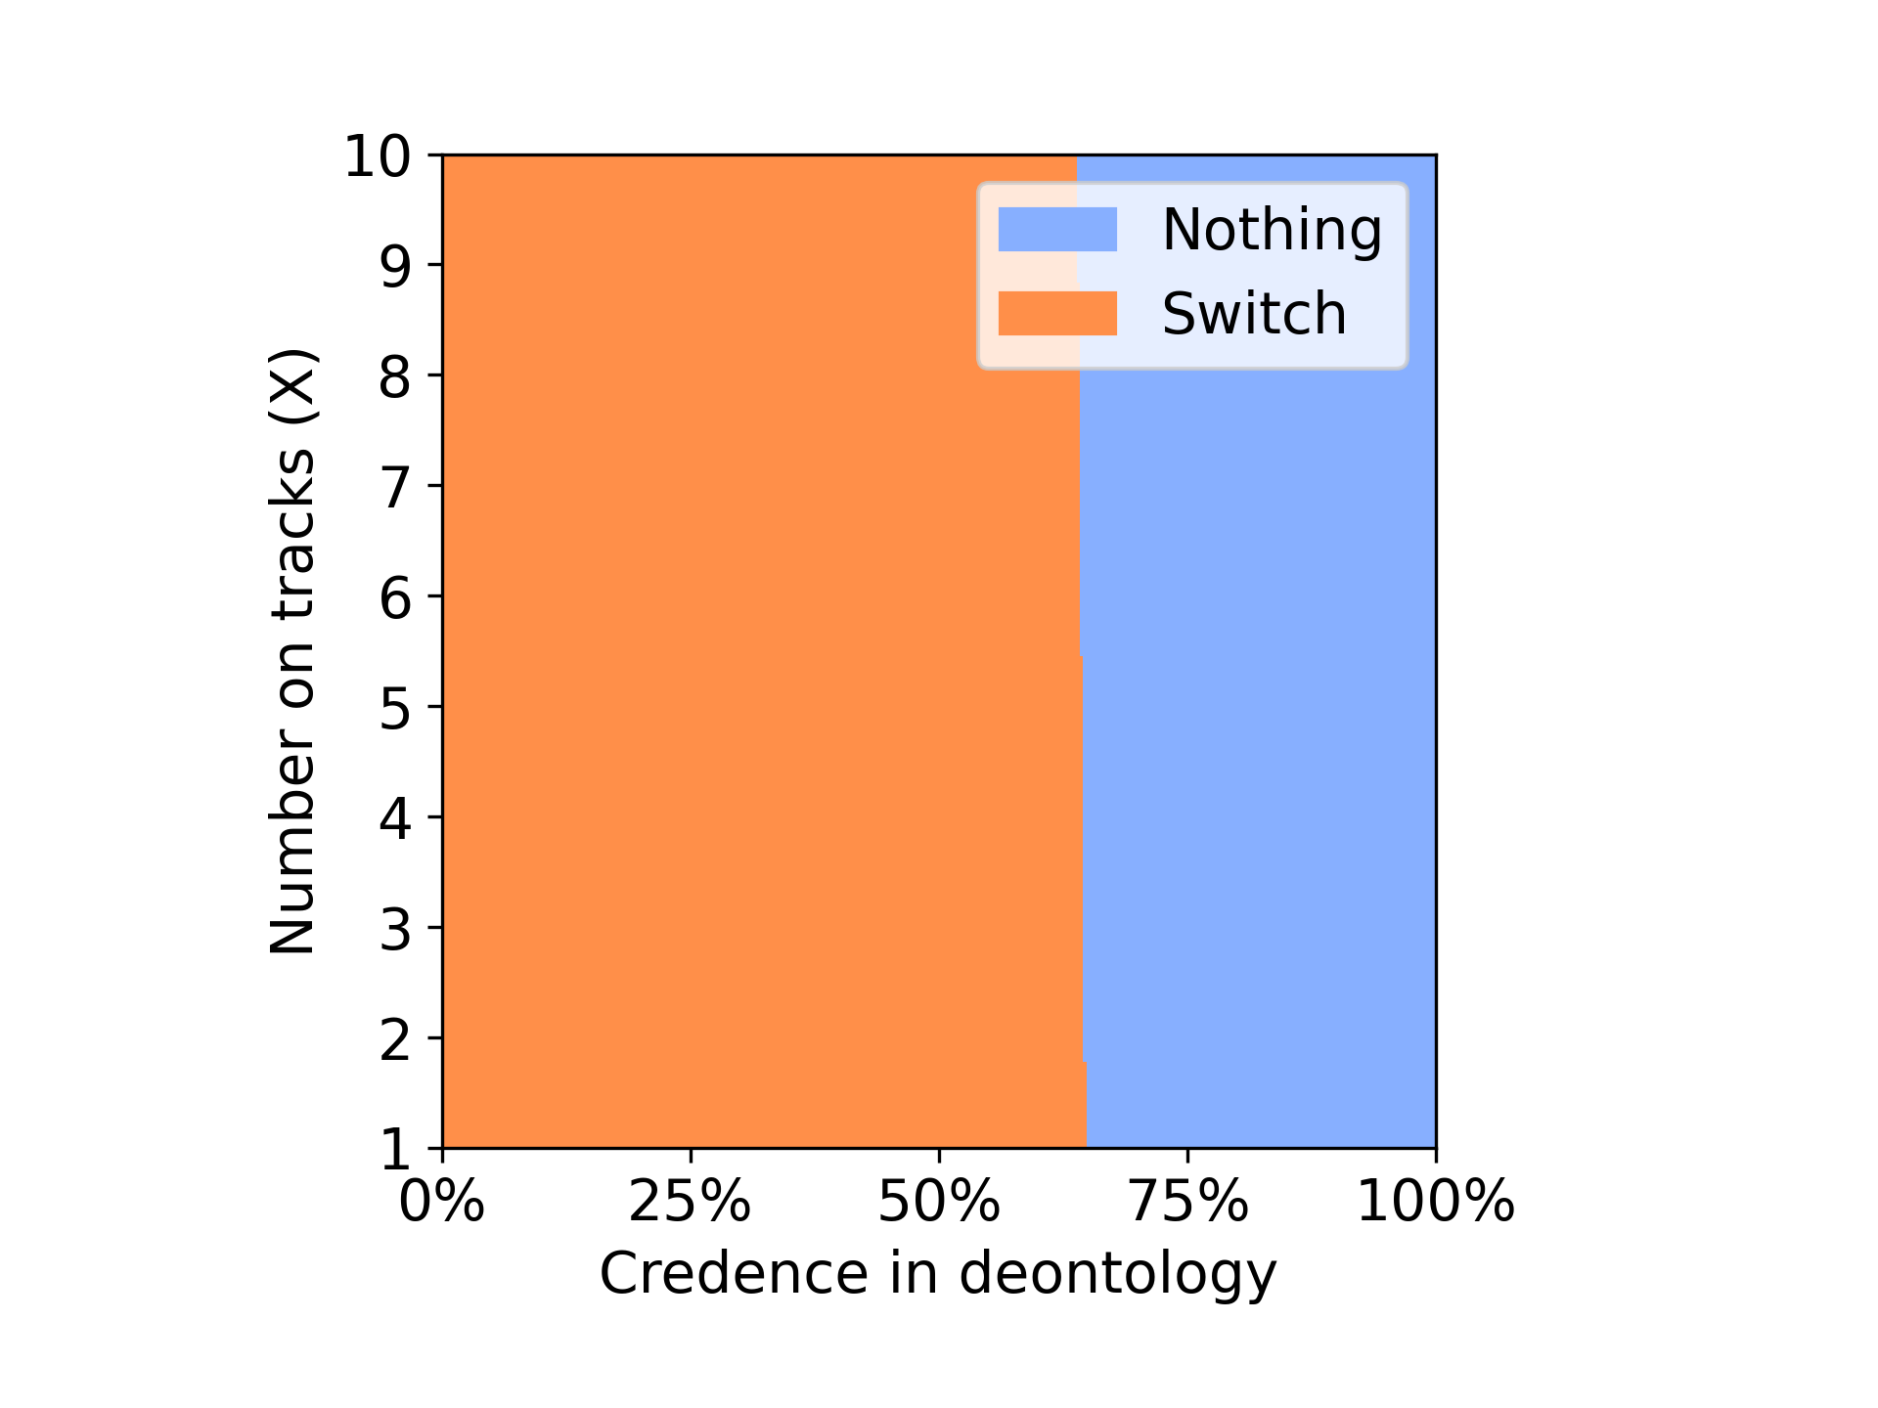
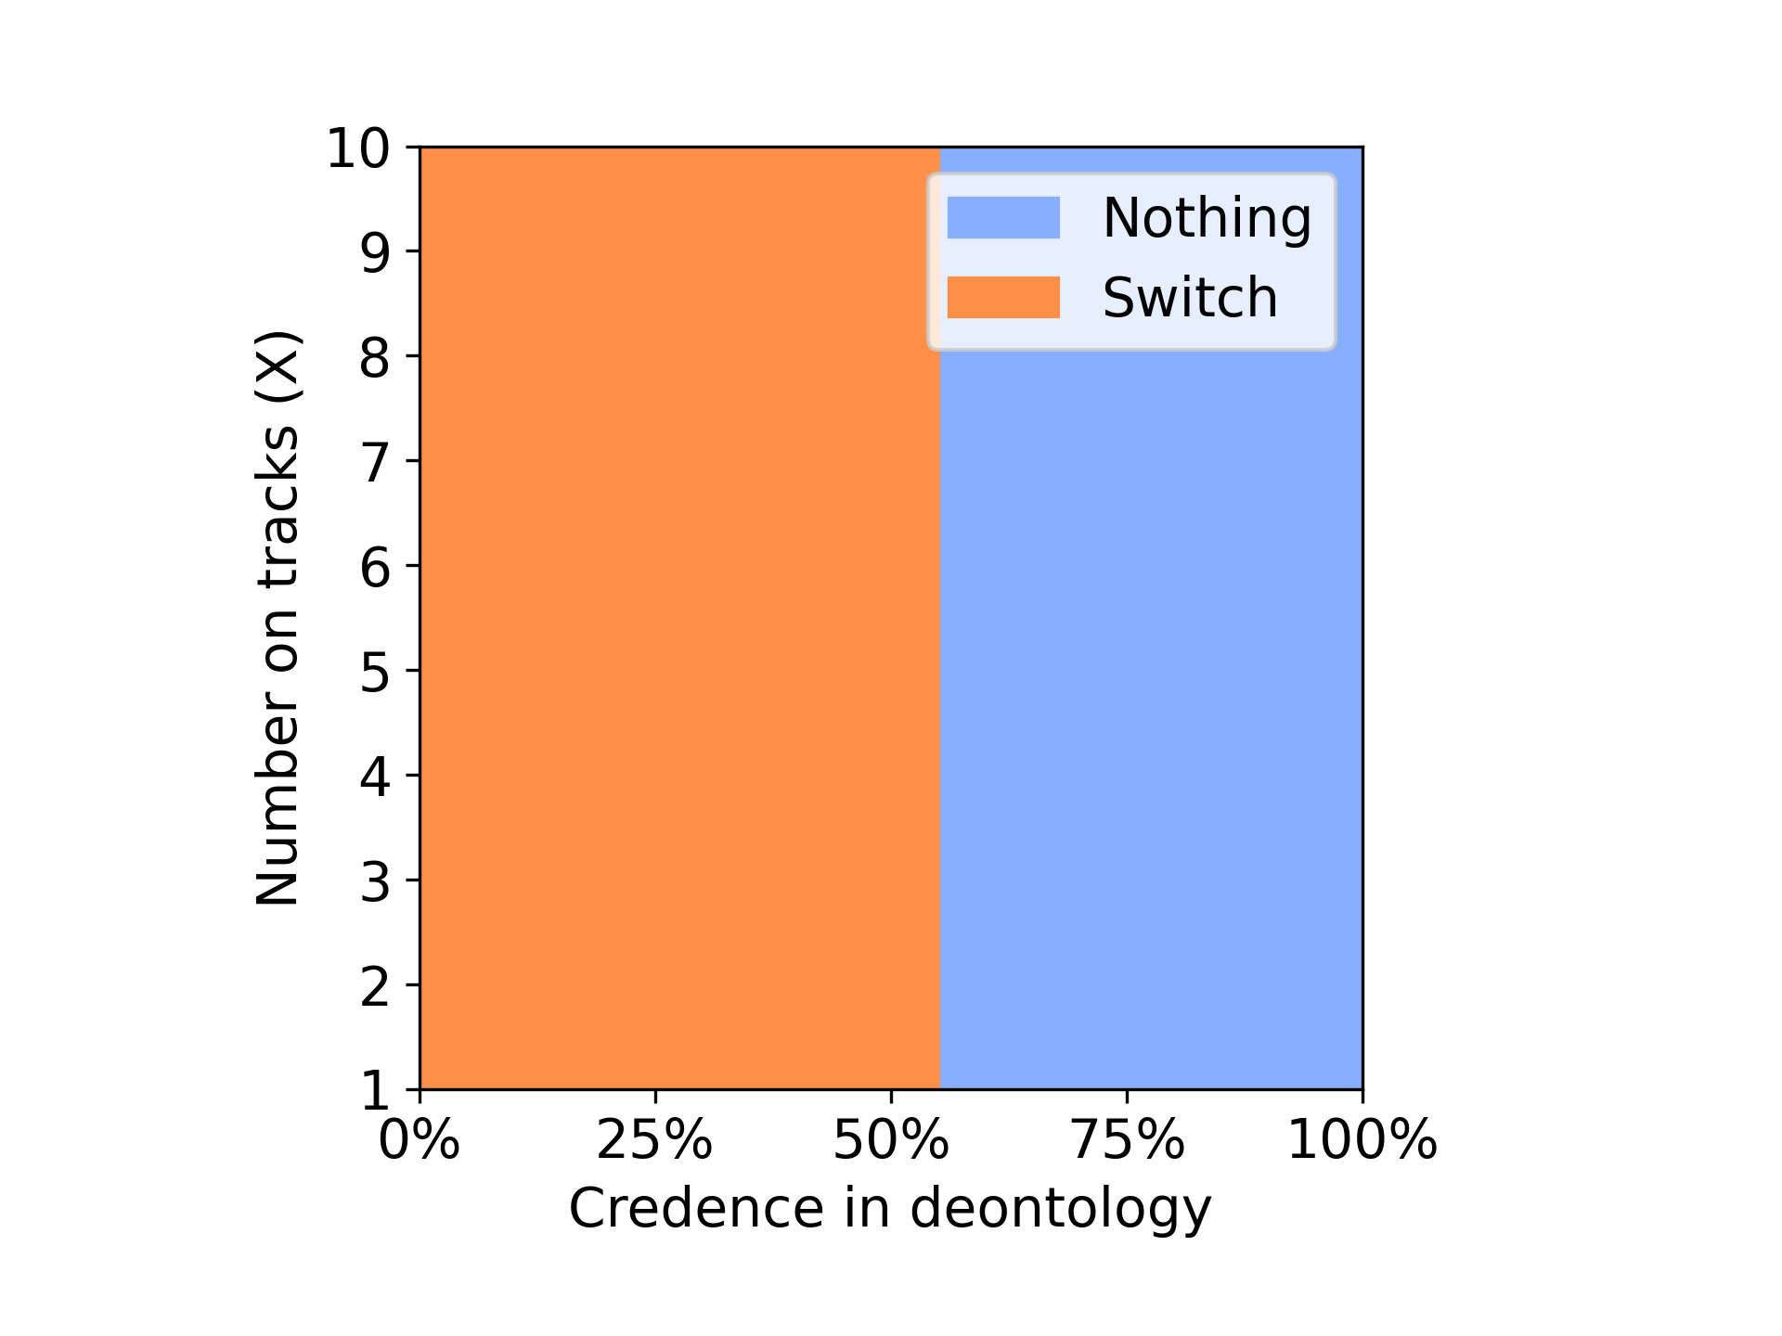
Env- Double, Voting method: variance
Random credence Dempster Credence
Notes:
In a Double environment with variance voting dempster credence showed no difference from the agent with random credence both at the end of training opt to choose nothing

Slide 14
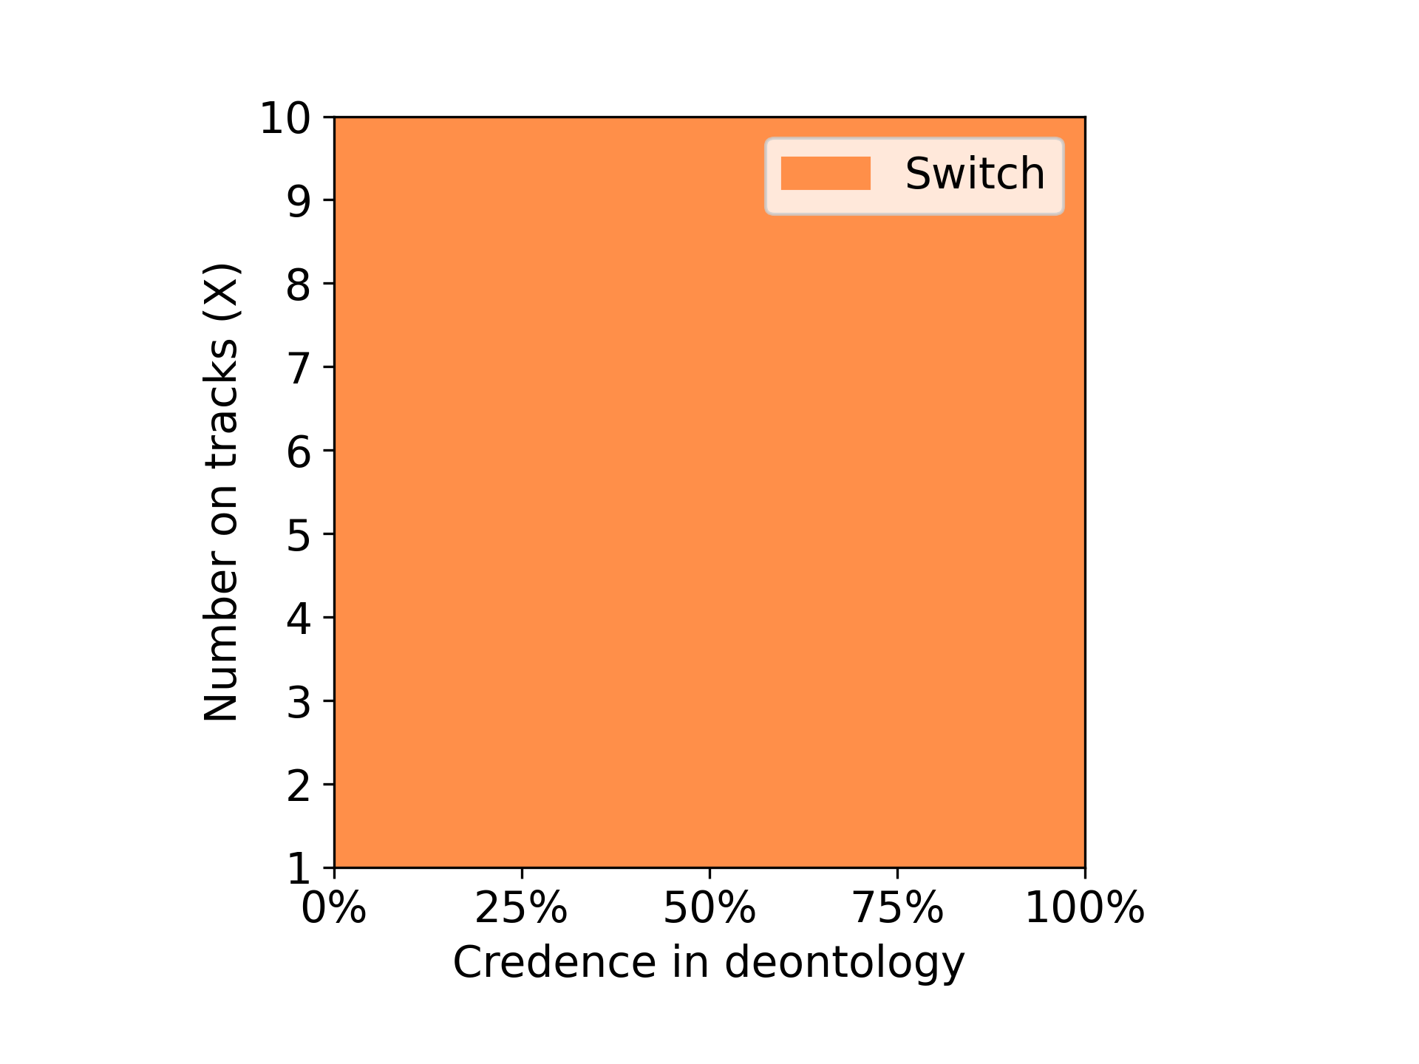
Env- Doomsday Voting method: nash
Random credence Dempster Credence
Notes:
In a doomsday event agent with dempster credence always chooses to switch in both nash and variance voting method.

Slide 15
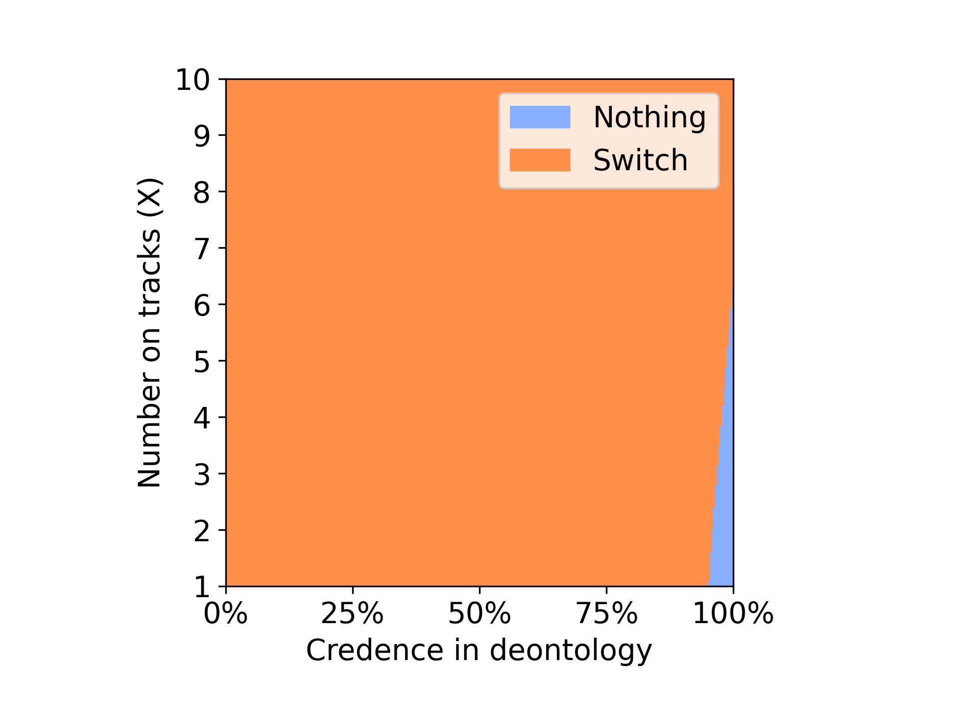
Env- Doomsday, Voting method: variance
Random credence Dempster Credence
Notes:
In a doomsday event agent with dempster credence always chooses to switch in both nash and variance voting method.

Slide 16
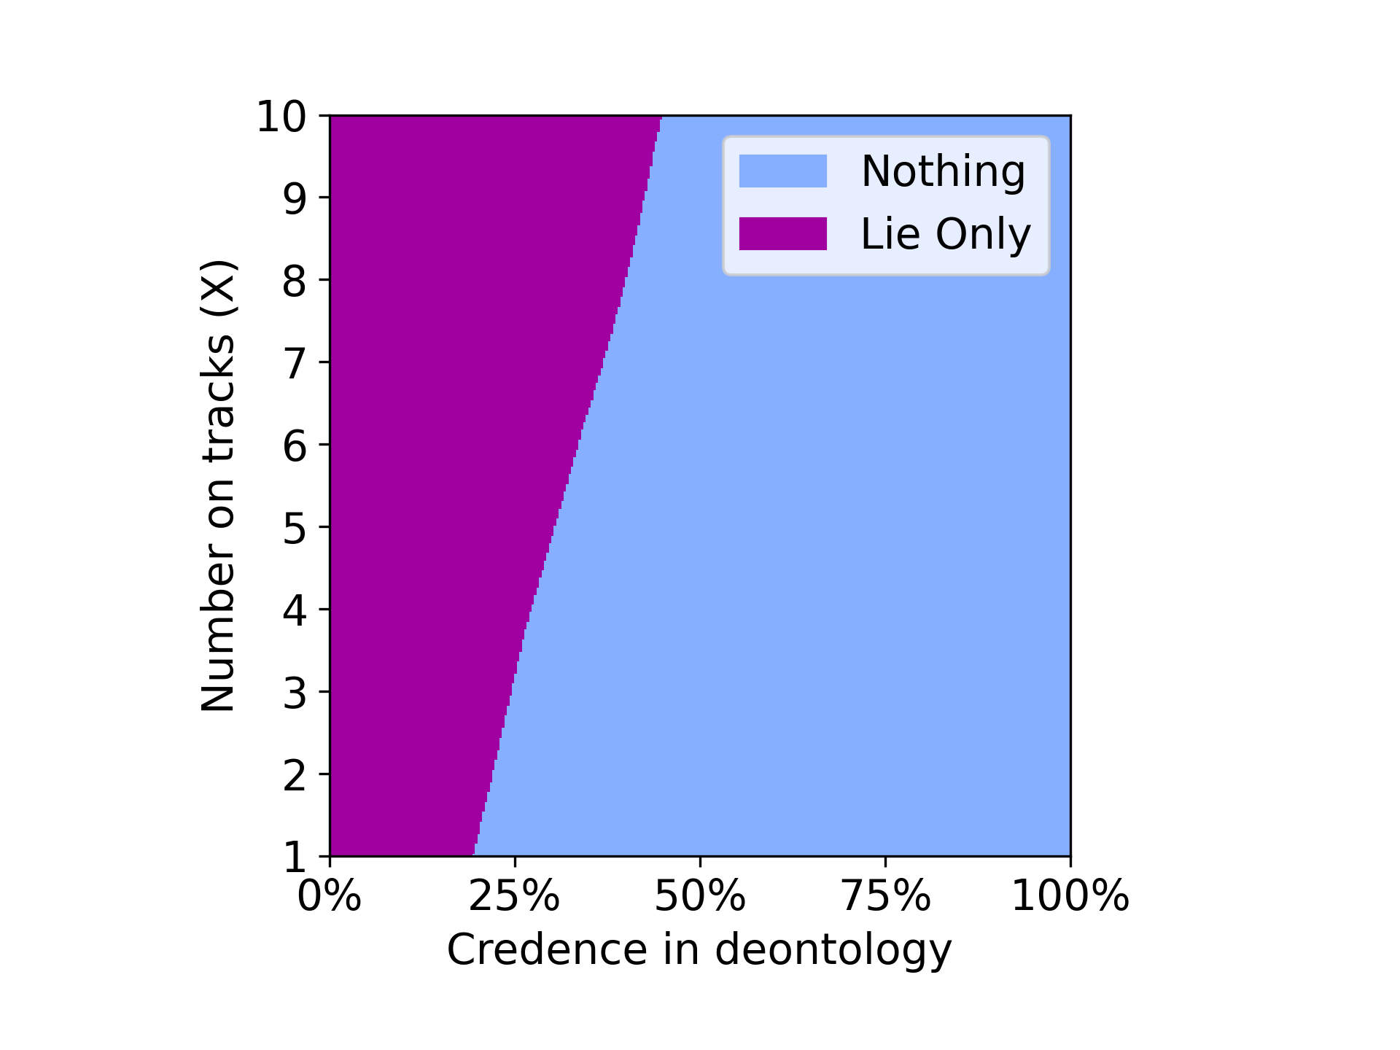
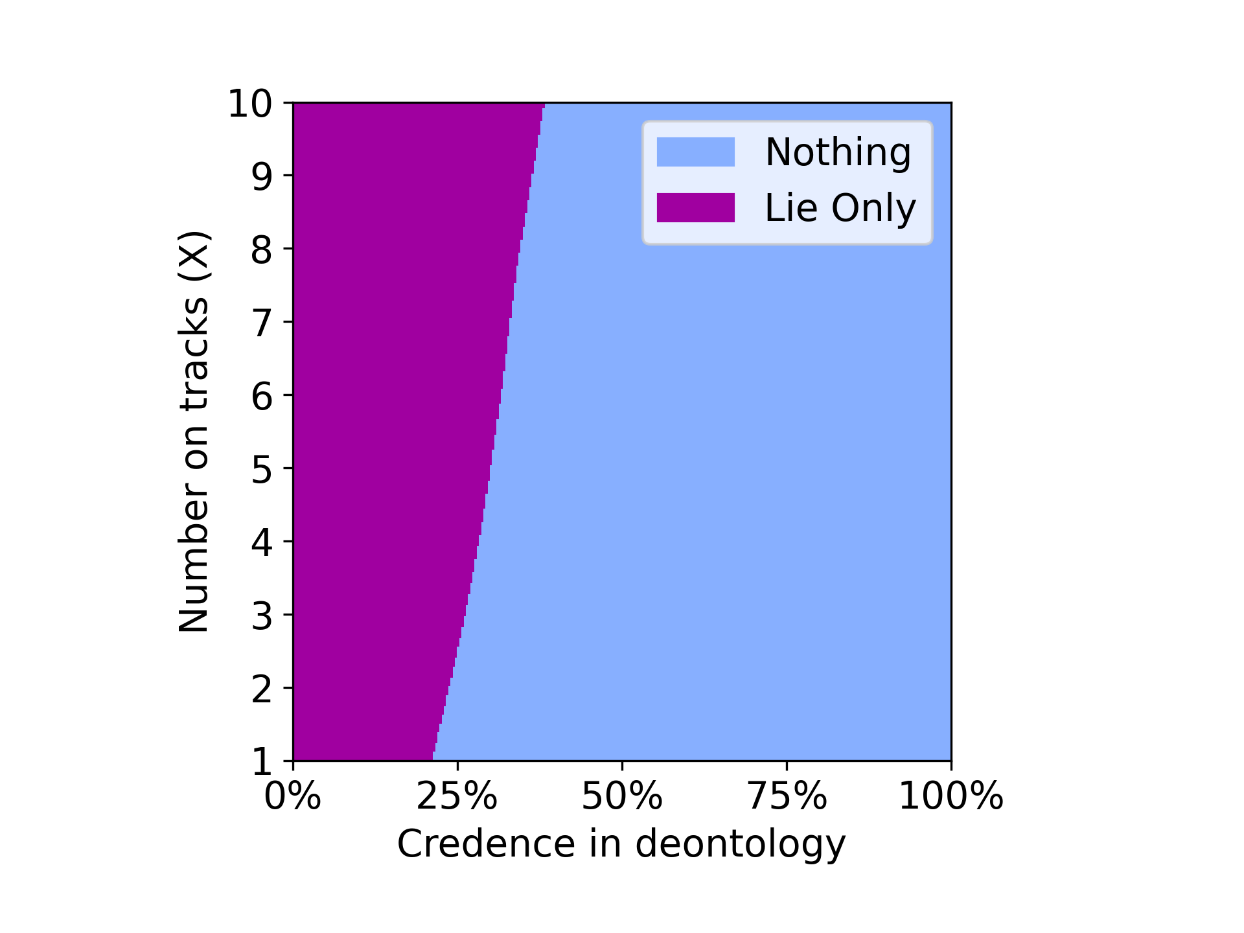
Env - guard ,Voting method: nash
Random credence Dempster Credence
Notes:
In a guard environment dempster credence didn't showed much variance in both nash and variance voting methods.

Slide 17
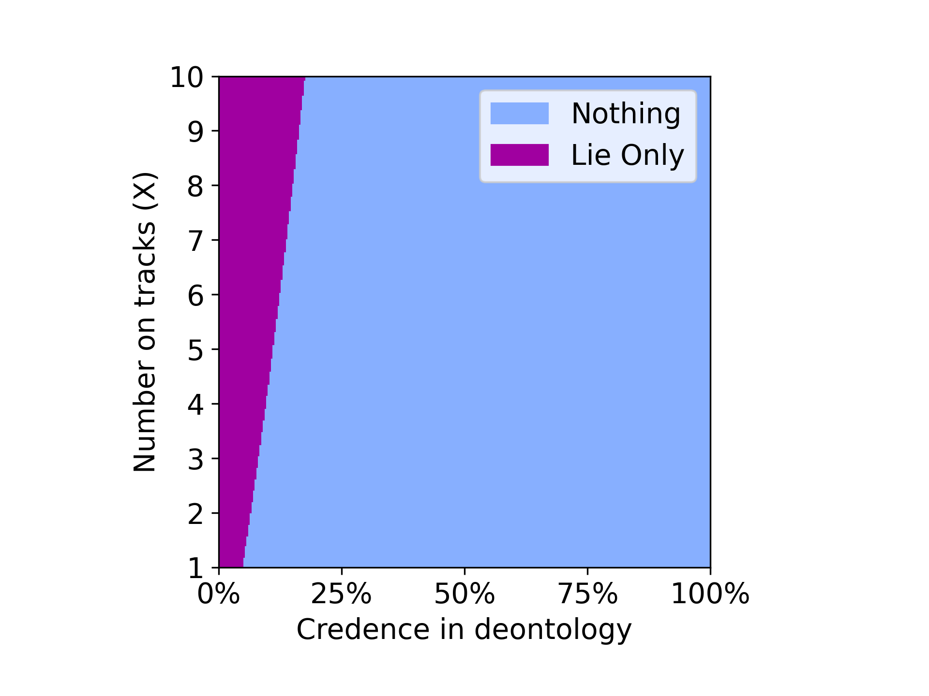
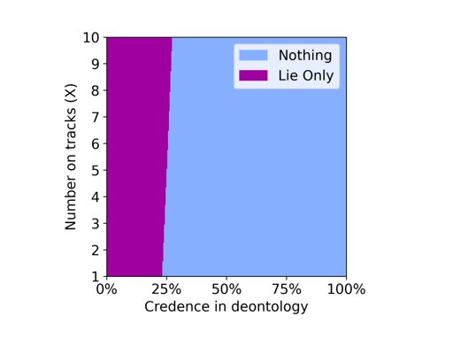
Env- guard, Voting method: variance
Random credence Dempster Credence
Notes:
In a guard environment dempster credence didn't showed much variance in both nash and variance voting methods.

